Slide 1
IPv4 Address

Slide 2
Note
An IPv4 address is 32 bits long.

Slide 3

Note
The IPv4 addresses are unique and universal.

Slide 4
The address space of IPv4 is
₂32
or 4,294,967,296.

Slide 5

Figure Dotted-decimal notation and binary notation for an IPv4 address

Slide 6

Find the error, if any, in the following IPv4 addresses.

Slide 7
Note
In classful addressing, the address space is divided into five classes: A, B, C, D, and E.

Slide 8
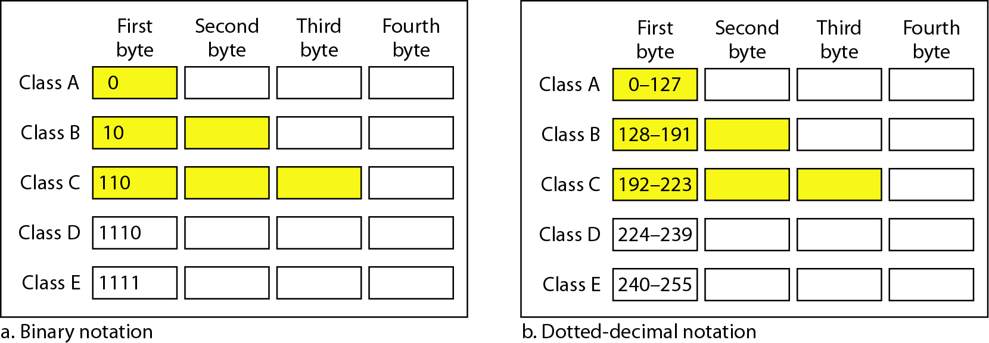
Figure Finding the classes in binary and dotted-decimal notation

Slide 9
Find the class of each address.
a. 00000001 00001011 00001011 11101111
b. 11000001 10000011 00011011 11111111
c. 14.23.120.8
d. 252.5.15.111

Slide 10
110NNNNN . NNNNNNNN . NNNNNNNN . HHHHHHHH Which class of IP does this belong Where: N = network ID bits and H = host ID bits
Class A
Class B
Class C
Class D

Slide 11
Ans C

Slide 12
Note
In classful addressing, a large part of the available addresses were wasted.

Slide 13
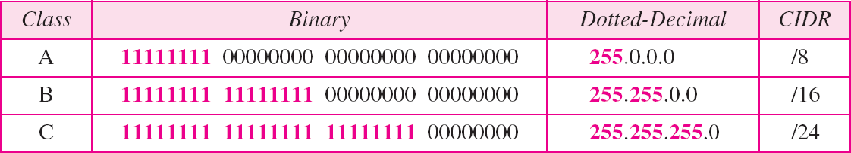
Table Default masks for classful addressing

Slide 14
Note
Classful addressing, which is almost obsolete, is replaced with classless addressing.

Slide 15
In IPv4 addressing, a block of addresses can be defined as
x.y.z.t /n
in which x.y.z.t defines one of the addresses and the /n defines the mask.

